Slide 1
Title - Loan Risk Analysis
Team - TechSperts
Proposed Solution
Web-Based Platform: Develop a user-friendly web platform for employees of a consumer finance company to review and manage loan applications.
Machine Learning-Driven Risk Analysis:
Implement a machine learning model (XGBoost) to analyze loan applicant data and generate predictions about the likelihood of default.
The model will assess key features such as income, loan amount, credit score, assets, and more to predict the risk associated with each applicant.
Graphical Representations of Decisions:
Use SHAP (SHapley Additive exPlanations) values to visually explain how individual features contributed to each prediction.
Verbal Explanations:
Provide employees with human-readable, verbal explanations for each decision, clearly stating why a loan was assessed as risky or not risky, based on the applicant’s profile and risk factors.

Slide 2
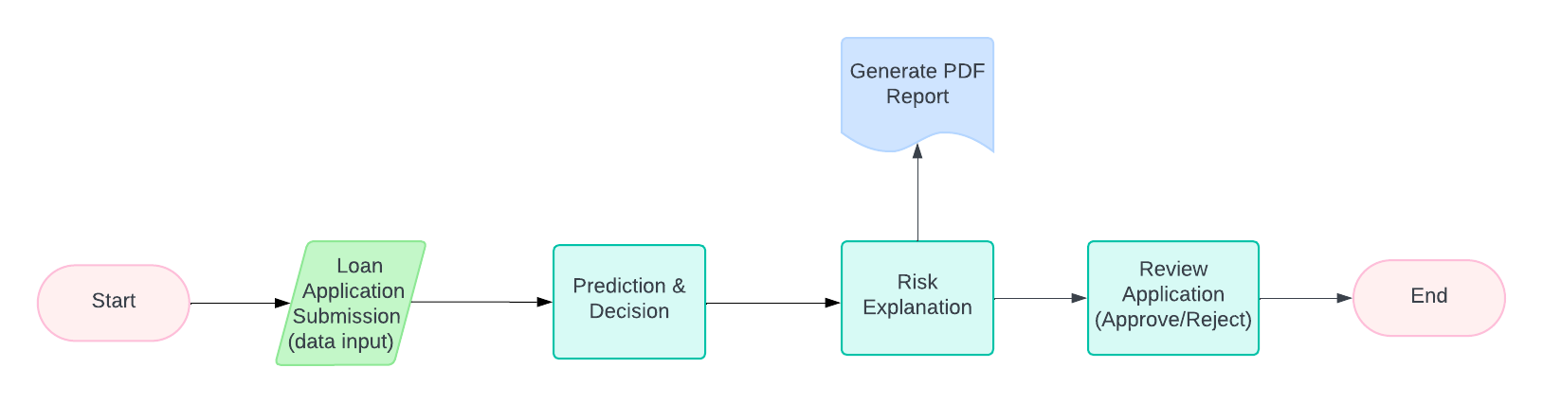
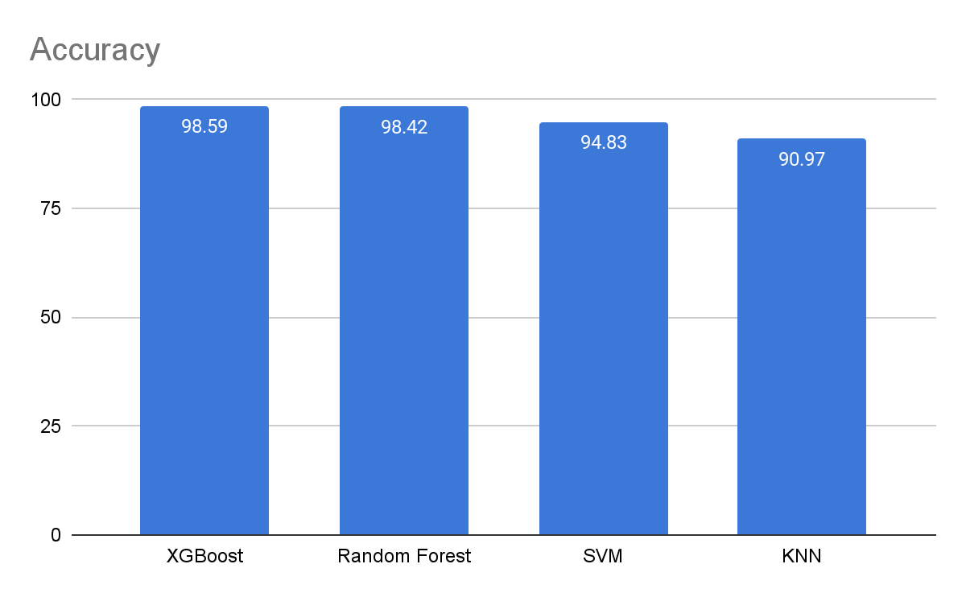
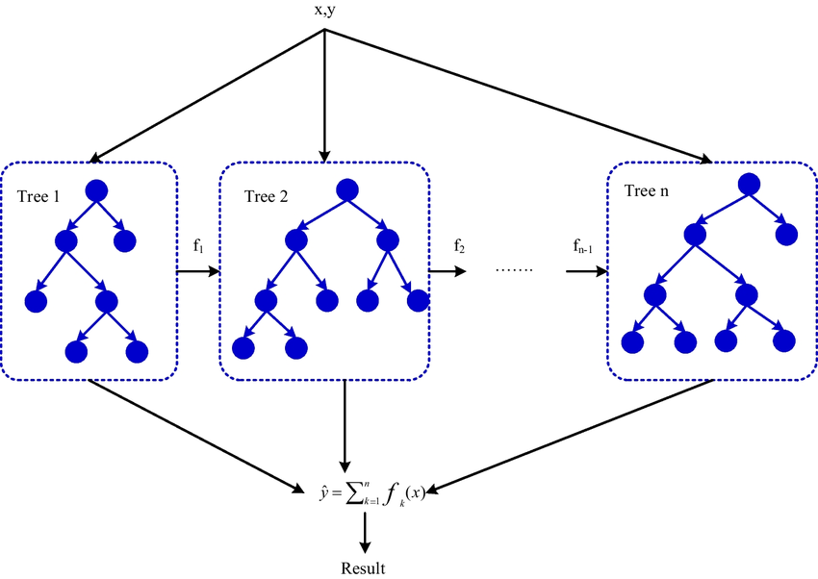
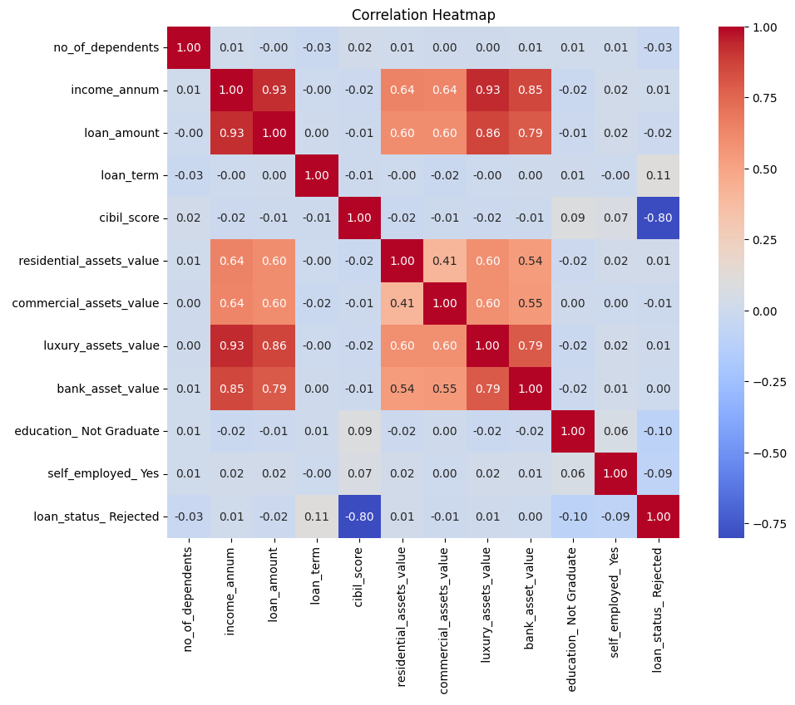
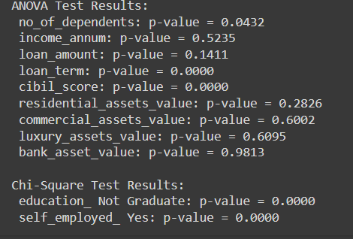
Loan Approval Dataset: cibil score, income, employment status, loan term, loan amount, assets value, and loan status. Link

Slide 3

Demo Video

